Slide 1
Grah Awastha

Slide 2
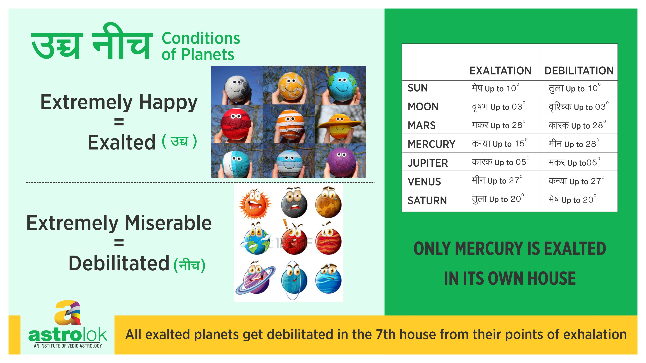

Slide 3
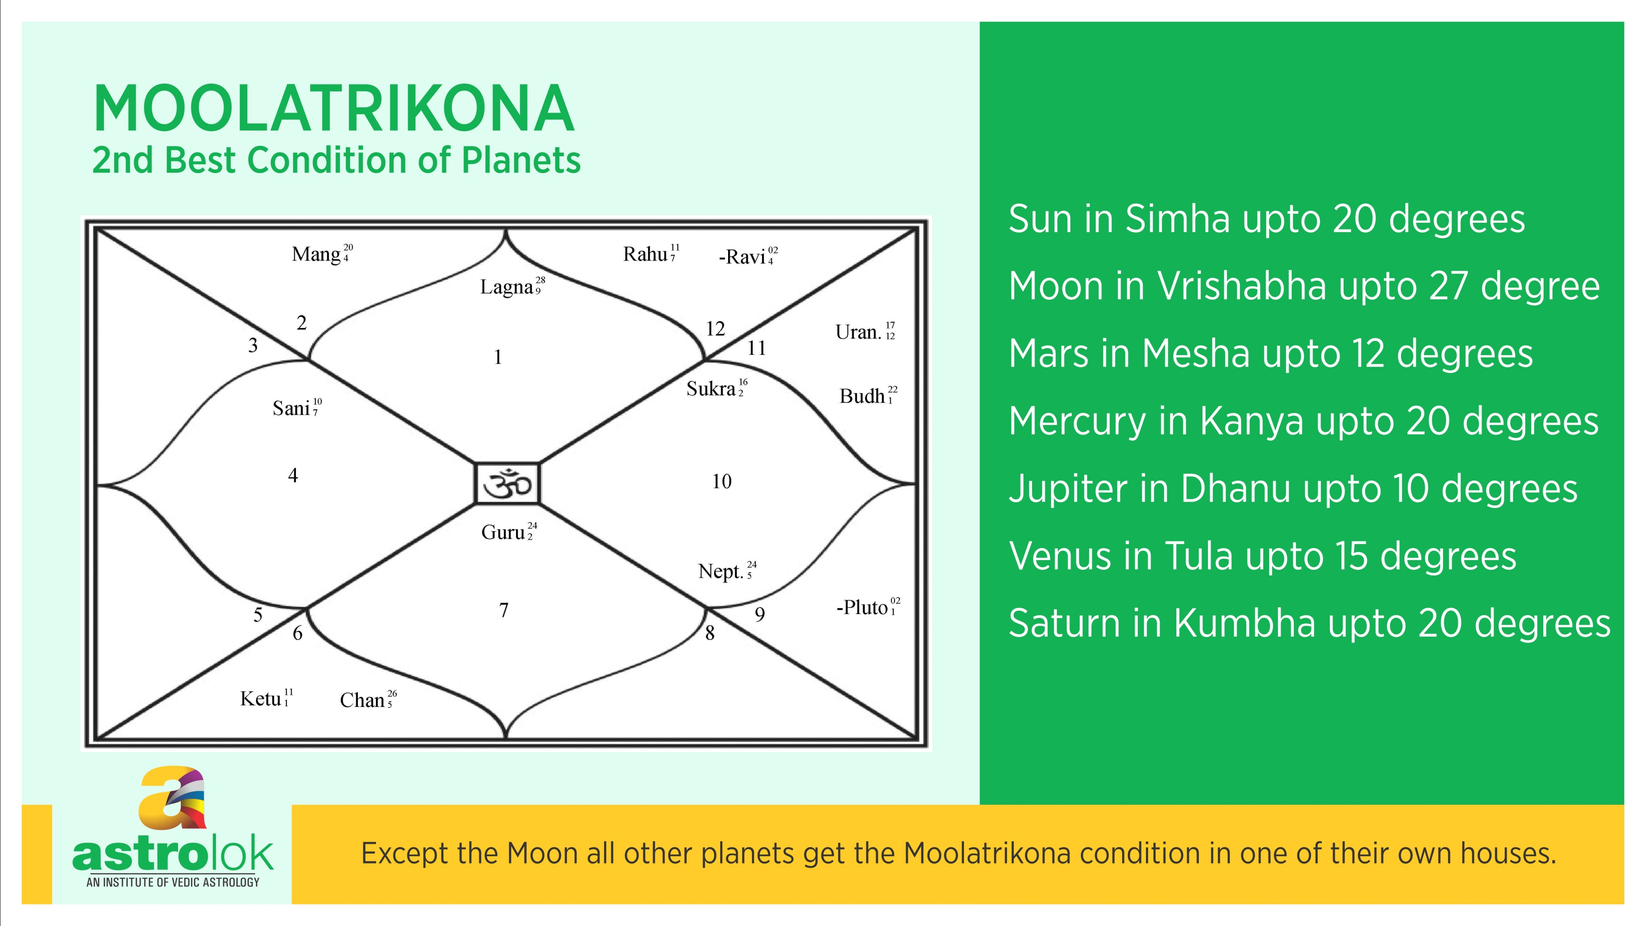

Slide 4
R# | Name | English | Bhachakra | Body parts | Elements | Dosha | Nature | Gender | Feet | Gunas | Varnas | Resorts | Strengt | Rising | Dirction
1 | Mesha | Aries | 0-30* | Head | Agni | Pitta | Cardinal | Male/cruel | Quadruped(4) | Rajas | Kshatriya | Hills | Night | Back | East
2 | Vrishabha | Taurus | 30-60* | Face | Prithvi | Vata | Fixed | Female/Tender | Quadruped | Rajas | Vaishyas | Villges | Night | Back | South
3 | Mithuna | Gemini | 60-90* | Arms | Vayu | All 3 | Dual | Male/cruel | Biped(2) | Rajas | Sudras | Villages | Night | Head | West
4 | Karka | Cancer | 90-120* | Heart | Jala | Kapha | Cardinal | Female/Tender | Centipede(40) | Satwik | Brahmins | Forests | Night | Back | North
5 | Simha | Leo | 120-150* | Stomach | Agni | Pitta | Fixed | Male/cruel | Quadruped | Satwa | Kshatriya | Forests | Day | Head | East
6 | Kanya | Virgo | 150-180* | Waist | Prithvi | Vata | Dual | Female/Tender | Biped | Tamas | Vaishyas | Hills | Day | Head | South
7 | Tula | Libra | 180-210* | Lower Abdomen | Vayu | All 3 | Cardinal | Male/cruel | Biped | Rajas | Sudras | Land | Day | Head | West
8 | Vrishchik | Scorpio | 210-240* | Genitals | Jala | Kapha | Fixed | Female/Tender | Centipede | Tamas | Brahmins | Water Land | Day | Head | North
9 | Dhanu | Sagittarius | 240-270* | Thighs | Agni | Pitta | Dual | Male/cruel | Biped, 15-30* Quadruped | Satwa | Kshatriya | Land | Night | Back | East
10 | Makara | Capricorn | 270-300* | Knees | Prithvi | Vaata | Cardinal | Female/Tender | 0-15* Quadruped, Footless | Tamas | Vaishyas | Forests Land | Night | Back | South
11 | Kumbha | Aquarius | 300-330* | Claves | Vayu | All 3 | Fixed | Male/cruel | Biped | Tamas | Sudras | Deep Water | Day | Head | West
12 | Meena | Pisces | 330-360* | Feet | Jala | Kapha | Dual | Female/Tender | Footless | Satwa | Brahmins | Water | Day | Both | North

Slide 5
Navagrahas | Sun | Moon | Mars | Mercury | Jupiter | Venus | Saturn | Rahu | Ketu
Areas | Temples | Water bodies | Fire place | Play Area | Treasure room | Bed room | Waste Storage | Anthills/termide | Anthills/termide
Tastes | Pungent | Salty | Bitter | Mixed | Sweet | Sour | Astringent
Directions | East | Nort west | South | North | North East | South East | West | South west | Center
Directional Strength | South | North | South | East | East | North | West
Trees | Big Strong Trees | Milky Trees | Biiter Fruits bearing trees | Fruitless Trees | Fruitful Trees | Flowery Trees | Thorny Trees
Cloth color | Red silk | White silken | Red | Black silken | Saffron/yellow | silken | multicolor robes | multicolors | rags
Seasons | summers | monsoon |  | Autumn | pre winter | spring | Winter
Gati/Rasi | 1 month | 2.25 days | 45 Days Approx | 20-25 Days | 13 Months | 25-30 days approx | 2.5 years | 1.5 Years | 1.5 Years
Exaltation points | 10* Aries | 3*Taurus | 28* Capricorn | 15* Virgo | 5* Cancer | 27* Pisces | 20* Libra
Debilitation points | 10*Libra | 3*Scorpio | 28* Cancer | 15* Pisces | 5* Capricorn | 27*virgo | 20* Aries
Own Rasi | Leo | Cancer | Aries, Scorpio | Gemini, Virgo | Sagittarius. Pisces | Taurus, Libra | Capricorn, Aquarius
Moola Trikona | 0-20* Leo | 3-30* Taurus | 0-12* Aries | 15-20* Virgo | 0-10* Sagi | 0-15* Libra | 0-20* Aqua
Friends | Mo, Ma, Ju | Su, Mer | Su, Mo, Ju | Su, Ve | SU, Mo, Ma | Me, Sa | Me, Ve
Neutral | Mer | Ma, Ju, Ve, Sa | Ve, Sa | Ma, Ju, Sa | Sa | Ma, Ju | Ju
Enemy | Ve, Sa | none | Mer | Mo | Mer, Ve | Mo, Su | Su, Mo, Ma
Maturity Age | 23 yrs | 26 yrs | 28 yrs | 32 yrs | 16 yrs | 27 yrs | 36 yrs | 42 yrs | 48 yrs
Aspect | 7th | 7th | 4th, 7th,8th | 7th | 5th, 7th, 9th | 7th | 3rd, 7th, 10th | 7th | none

Slide 6
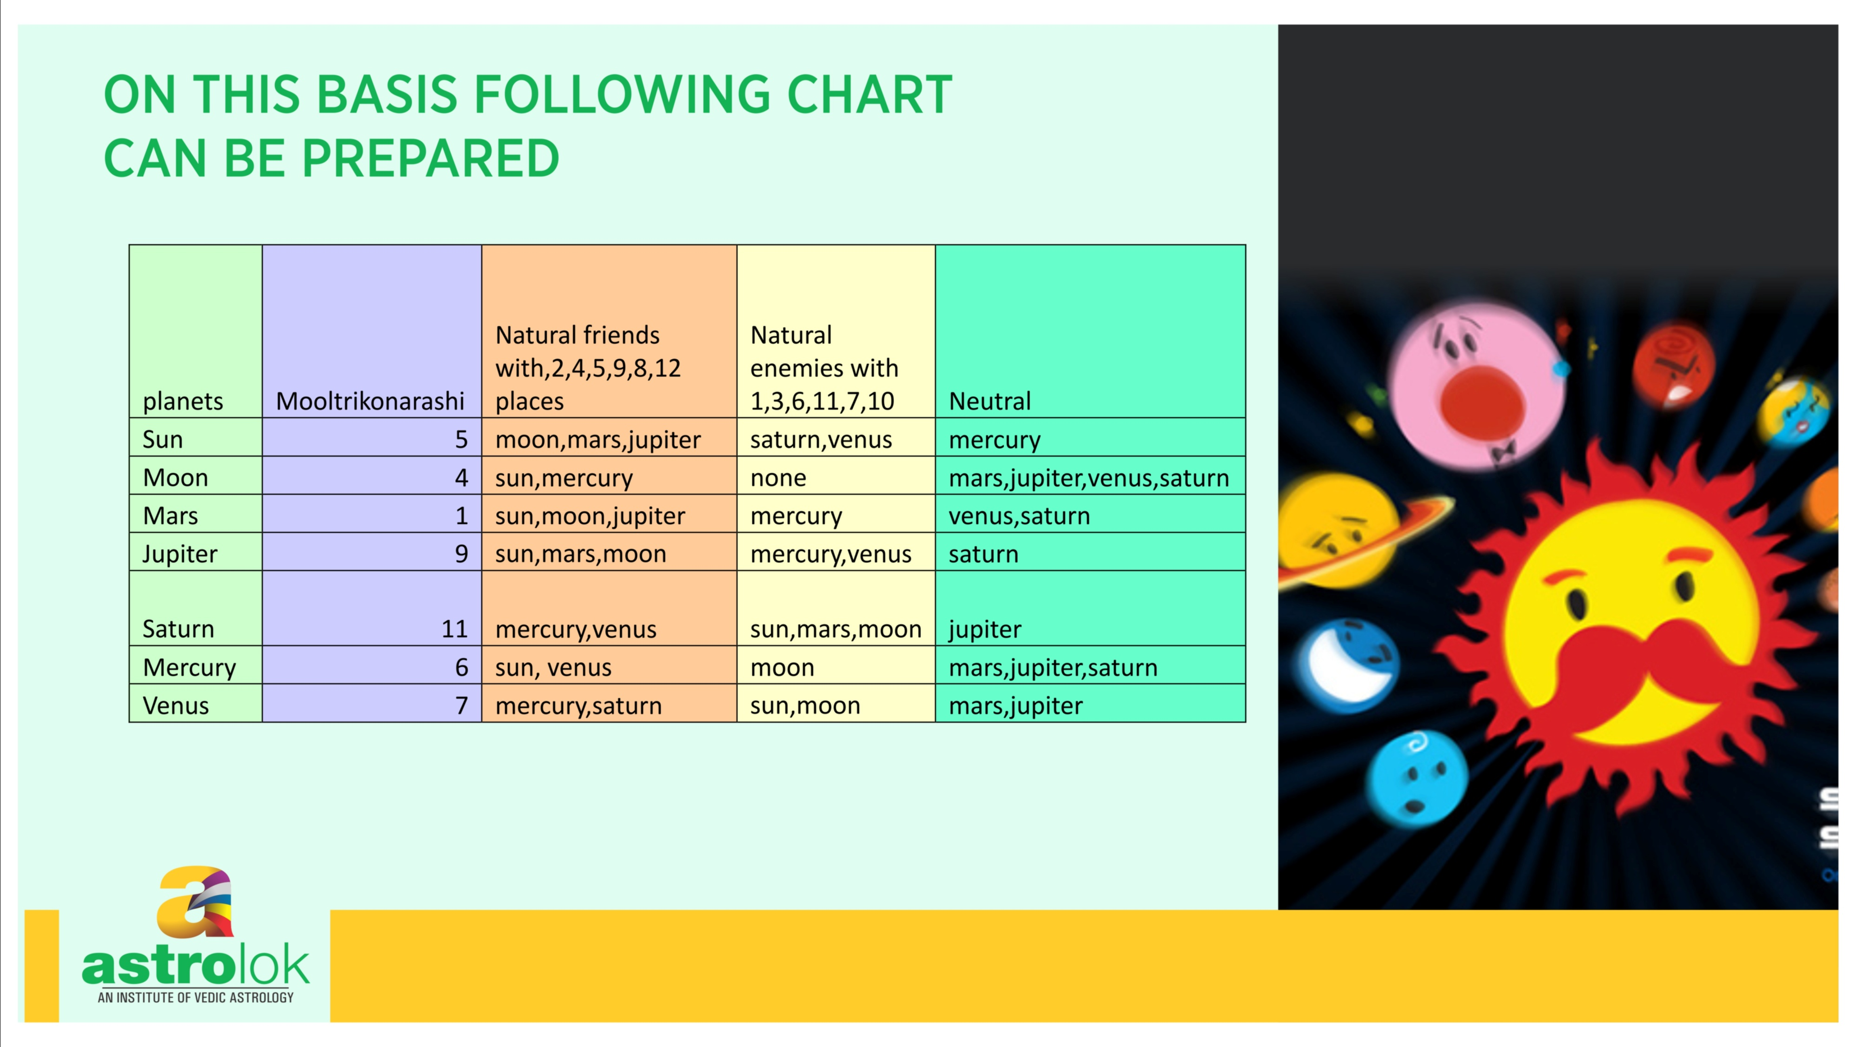
Planet | Mooltrikon Rashi | Natural Friend (2,4,5,8,9,12) | Natural Enemy (3,6,7,10,11) | Neutral
Sun | 5 | Mars, Jupiter Moon | Venus, Saturn | Mercury
Moon | 2 | Sun, Mercury | none | Mars, Jupiter, Venus, Saturn
Mars | 1 | Moon, Sun, Jupiter | Mercury, Saturn | Venus
Jupiter | 9 | Mars, Moon, Sun | Venus, Mercury | Saturn
Saturn | 11 | Venus, Mercury | Mars, Moon, Sun | Jupiter
Mercury | 6 | Venus, Sun | Moon | Jupiter, Mars, Saturn
Venus | 7 | Saturn, Mercury | Moon, Sun | Jupiter*, Mars
Rahu |  | Mercury,Saturn venus | Sun,moon,Jupiter | mars
ketu |  | Mars, venus, saturn | Sun,moon | Mercury, jupiters
* Venus exalts in Pisces and in mythology Venus was impostor of Jupiter. Hence even though rule wise Jupiter is natural enemy, we categorize as Neutral overall.

Slide 7

Retrogression
All the planets move in a clockwise motion around the zodiac at different speeds and there will be a time when a particular planet will appear from the earth as stationary.
It would seem to be moving in an anticlockwise direction from the earth.
The anticlockwise motion is called as retrograde, and it occurs in several stages.
The planets are closest to the earth, so appear retrograde.
At first, it seems that the planet is still and then goes backwards through the signs.
The time that a planet spends in a retrograde motion depends on the orbit of the planet.

Slide 8
Cheshta Bala - motional strength
Vakra: Retrogression and moving in reverse gear: 100% strength
Anuvakra: Entering the previous Rāśi in retrograde motion i.e., moving Rāśi in reverse gear: 60% strength
Vikala: Devoid of motion i.e., standstill: 15%
Manda: Slowing down and decelerating, in direct motion: 30%
Mandatara: Decelerating even more and coming to near standstill 15%
Sama: Somewhat accelerating: 7.5%
Chara: Moving in direct motion with average speed: 45%
Atichara: Moving much faster than the average speech: 30%

Slide 9
Retrograde or vakri planet gives unusual results and is represented with (R) in front of its position in the chart.
Sun and Moon never go retrograde, while Rahu and Ketu are always retrograde.
Retrogrades in the birth chart signify lot of desires. Most people have two or three planets retrograde in the chart.
Usually, auspicious planets produce positive results while inauspicious planets produce negative results during retrogression.
The retrograde planet sometimes moves back to the previous zodiac sign and at other times, it remains in the same sign. It produces results of the previous house also.
The retrograde motion of planets gives different results.

Slide 10
The planets are retrograde when they are 6th, 7th, 8th or 12th from the Sun.
Jupiter, Mars and Saturn are retrograde when they are 180ᵒ near the Sun.
The retrograde planets are away from the Sun and can have a positive or negative aspect without the Sun’s control.
Retrograde planets show that the native has a pending karma that needs to be finished through hard work.
The planet is strong, so helping the native to clear these karmas.
Having one retrograde planet in the chart is good if one follows the direction of the planet.
Two or three retrograde planets give struggle.
If a retrograde planet is in an exalted sign, it will give bad and unfavourable results and a debilitated planet, if retrograde, gives good results.

Slide 11
The Retrograde Time of Planets
Planet | Revolutions around the Sun | Occurrence | Duration of Retrograde | Effects
Mercury | 88 days | 3/4 times a year | 3 weeks | Feels misunderstood, should consider before speaking.
Venus | 225 days | Every 18 months | 40-44 days | Can become obsessed in relationships.
Mars | 687 days | Every 26 months | 60-80 days | Can become depressed and difficulty in expressing anger.
Jupiter | 12 years | Every 13 months | 4 months | Has doubts about what they deserve, feel superior inside.
Saturn | 30 years | Every 12.5 months | 4.5 months | Feels they are never good, hides fear.

Slide 12
Combustion
The Earth is the center, and all the planetary positions are calculated with reference to the Earth.
All the planets revolving around the Sun get closer to the Sun to a certain degree and lose their energy and power, known as combustion of planets.
When the Moon comes in the same sign as the Sun, it creates an Aamvasya dosh. It does not get combust as it gets light from the Sun.
Rahu and Ketu are more powerful than the Sun and the Moon, so can eclipse them.
The heat of the Sun burns the planet, so it sends less rays to the Earth and creates a negative impact to give fewer results.
According to Rishi Parashar, the combustion of a planet is a promise by the Sun that he will take care.

Slide 13
The planet is powerless and is not able to perform because of the combustion.
Combustion is a permanent damage.
A benefic planet which loses powers and positivity, fails to give positive results. A malefic planet turns more malefic and gives serious problems and danger.
Mercury, Venus and Mars are fast planets and are closer to the Sun, so are combust often.
Jupiter and Saturn are far from the Sun, so they have a late combustion.
The impact of the Sun is around or in the same house depending on the degree of the planet.

Slide 14
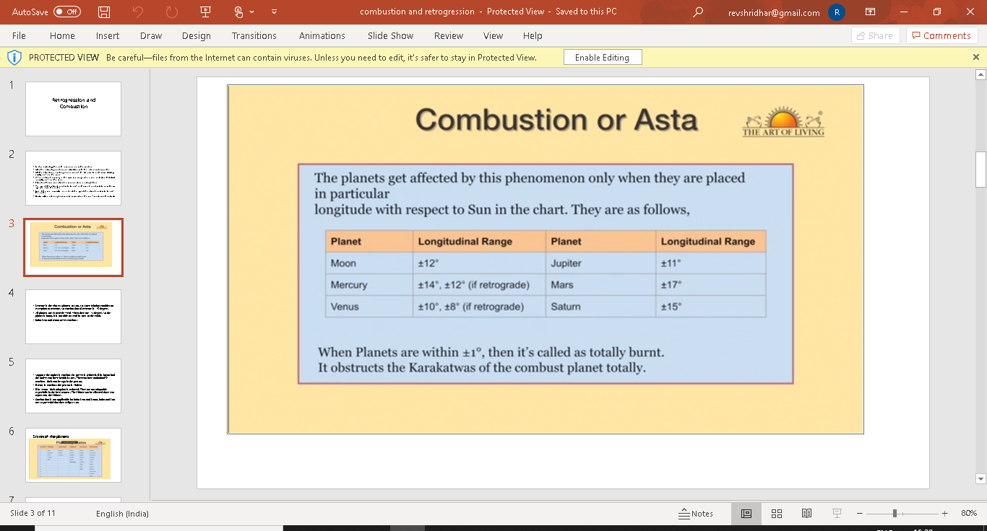

Slide 15
The combust planet represents the responsibilities the native has not completed in their last birth or has misused the freedom, so has come under the control of Sun.
A combust planet in an enemy sign, debilitated or in the 6th, 8th or 12th house in the chart will give bad results during the Dasha and Antardasha.
A combust Mars does not affect much as Mars is fire.
A combust Mercury can impact the native’s intelligence and communication.
A combust Jupiter makes the native egoistic, a strict teacher, with an authoritative style of teaching.
A combust Venus makes the native stubborn and does not adjust in matters of love.

Slide 16
It is okay to have a combust planet in a chart if there are two or three planets. The only remedy is to change their lifestyle and take a spiritual path.
Praying to Sun will relieve the planet to give better results.
Chanting the Gayatri Mantra, spiritual cleansing and Sandhya Vandhan are important.

Slide 17
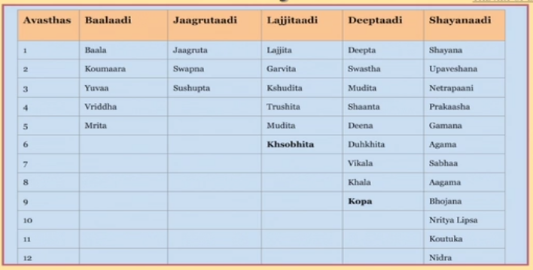
Conditions of Planets

